Slide 1
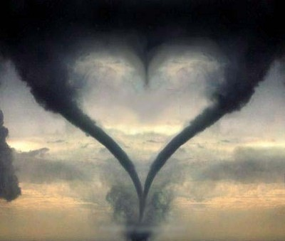

Finding God in the Storm
A CD of this message will be available (free of charge) immediately following today's message
This message will be available via podcast later this week at calvaryokc.com

Slide 2
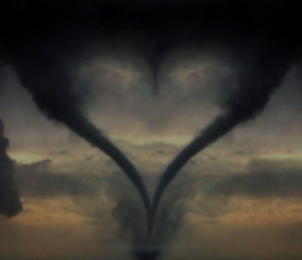
Finding God in the Storm
James 1:2-8 ~ ² My brethren, count it all joy when you fall into various trials, ³ knowing that the testing of your faith produces patience. ⁴ But let patience have its perfect work, that you may be perfect and complete, lacking nothing. ⁵ If any of you lacks wisdom, let him ask of God, who gives to all liberally and without reproach, and it will be given to him. ⁶ But let him ask in faith, with no doubting, for he who doubts is like a wave of the sea driven and tossed by the wind. ⁷ For let not that man suppose that he will receive anything from the Lord; ⁸ he is a double-minded man, unstable in all his ways.

Slide 3
Finding God in the Storm

Slide 4
Finding God in the Storm
John 16:33 ~ These things I have spoken to you, that in Me you may have peace. In the world you will have tribulation; but be of good cheer, I have overcome the world.

Slide 5
Finding God in the Storm

Slide 6
Finding God in the Storm
Rom. 8:28 ~ And we know that all things work together for good to those who love God, to those who are the called according to His purpose.

Slide 7
Finding God in the Storm

Slide 8
Finding God in the Storm
Luke 13:1–5 ~ ¹ There were present at that season some who told Him about the Galileans whose blood Pilate had mingled with their sacrifices. ² And Jesus answered and said to them, “Do you suppose that these Galileans were worse sinners than all other Galileans, because they suffered such things? ³ I tell you, no; but unless you repent you will all likewise perish. ⁴ Or those eighteen on whom the tower in Siloam fell and killed them, do you think that they were worse sinners than all other men who dwelt in Jerusalem? ⁵ I tell you, no; but unless you repent you will all likewise perish.”

Slide 9
Finding God in the Storm

Slide 10
Finding God in the Storm
1 Pet. 4:12-13 ~ ¹² Beloved, do not think it strange concerning the fiery trial which is to try you, as though some strange thing happened to you; ¹³ but rejoice to the extent that you partake of Christ’s sufferings, that when His glory is revealed, you may also be glad with exceeding joy.

Slide 11
Finding God in the Storm

Slide 12
Finding God in the Storm
Charles II (1630-1685)~ "Your blindness is a judgment from God for the part ou took against my father"
John Milton (1608-1674) ~ "If I have lost my sight through God’s judgment, what can you say of your father who lost his head?"
"It is not miserable to be blind; it is miserable to be incapable of enduring blindness."

Slide 13
Finding God in the Storm
Malcolm Muggeridge (1903-1990) ~ "Supposing you eliminated suffering, what a dreadful place the world would be! I would almost rather eliminate happiness. The world would be the most ghastly place because everything that corrects the tendency of this unspeakable little creature, man, to feel over-important and over-pleased with himself would disappear. He's bad enough now, but he would be absolutely intolerable if he never suffered. However, we needn't fear that."

Slide 14
Finding God in the Storm

Slide 15
Finding God in the Storm
Job 40:1-6 (NLT) ~ ¹ Then the LORD said to Job, ² "Do you still want to argue with the Almighty? You are God’s critic, but do you have the answers?" ³ Then Job replied to the LORD, ⁴ "I am nothing — how could I ever find the answers? I will cover my mouth with my hand. ⁵ I have said too much already. I have nothing more to say."
⁶ Then the LORD answered Job from the whirlwind: ⁷ "Brace yourself like a man, because I have some questions for you, and you must answer them."

Slide 16
Finding God in the Storm
Matthew 7:24–27 ~ ²⁴ Therefore whoever hears these sayings of Mine, and does them, I will liken him to a wise man who built his house on the rock: ²⁵ and the rain descended, the floods came, and the winds blew and beat on that house; and it did not fall, for it was founded on the rock.
²⁶ But everyone who hears these sayings of Mine, and does not do them, will be like a foolish man who built his house on the sand: ²⁷ and the rain descended, the floods came, and the winds blew and beat on that house; and it fell. And great was its fall.

Slide 17
Finding God in the Storm

Slide 18
Finding God in the Storm
2Co 12: 9 ~ "My grace is sufficient for you, for My strength is made perfect in weakness."
Psa_65:6 ~ Who established the mountains by Your strength, … clothed with power;
Col. 1:17 ~ And He is before all things, and in Him all things consist.

Slide 19
Finding God in the Storm

